Slide 1
Welcome to Arabic
New Paltz High School

Slide 2
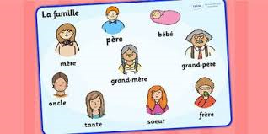


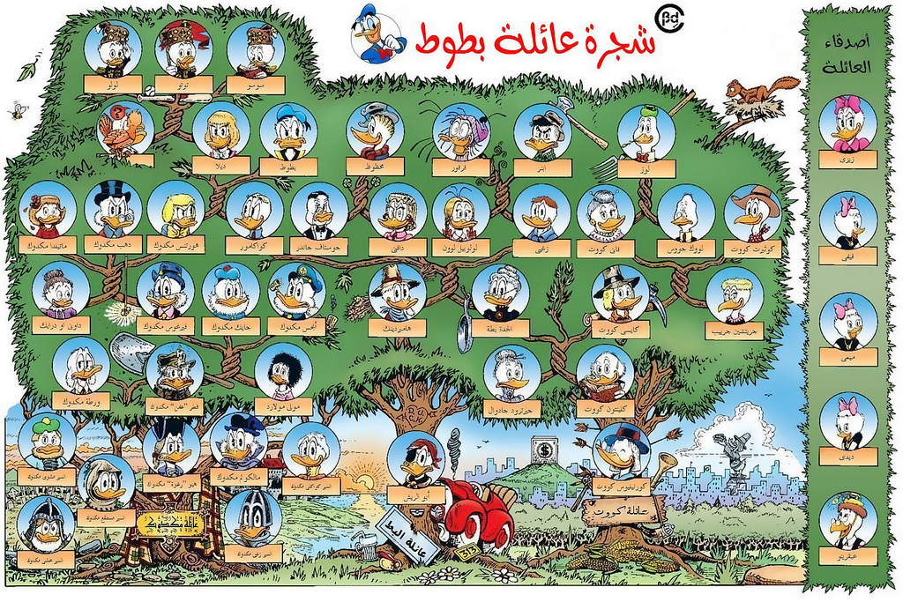
Review family and Family members
What is

Slide 3
Mother
http://www.amberpricedesigns.com/old_site/technology/captivate/family_tree/family_tree.htm

Slide 4
Brother

Slide 5
Father

Slide 6
Sister

Slide 7
Uncle
Mother’s side

Slide 8
Auntie
Mother’s side

Slide 9
Grand papa

Slide 10
Grand mother

Slide 11
Husband

Slide 12
Wife

Slide 13
Uncle

Slide 14
Son

Slide 15
Daughter

Slide 16
Family

Slide 17
Tree

Slide 18
Beautiful

Slide 19
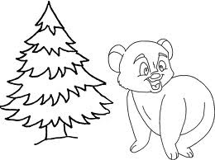
بِجانِب

Slide 20

علَى

Slide 21
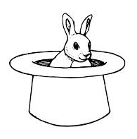
في

Slide 22

تَحتَ

Slide 23
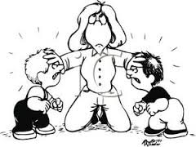
: بَيْنَ

